Slide 1


PROJECT MARATHON
Software Development & Testing
Training and Placement Center.
UNDER THE GUIDANCE OF
VIGNESH SIR
FULL STACK DEVLOPER
PRESENTED BY
HRITHIK GUPTA
7020823933

Slide 2
INTRODUCTION
In today’s fast-paced world ,where health and fitness are paramount importance ,managing a gym efficiently has become a critical task. This project seeks to address this challenge by offering a user-friendly system.
In a fitness industry that demands innovation and efficiency ,our project is designed to help gym owners optimize their operations and enhanced experience to their members.

Slide 3
OBJECTIVE
Offer a user-friendly interface accessible through web devices for convenient access.
Simplify the process of member profiling and information storage.
To improved financial management through online payment processing this improved overall financial transparency.
To implementation of a digital membership system which help to reduced administrative workload and minimized errors related to membership data.

Slide 4
SOFTWARE REQUIREMENT
HARDWARE & SOFTWARE REQUIREMENT
HARDWARE REQUIREMENT
Processor : 12th Gen Intel(R) Core(TM) i5-1235U
RAM : 2.00GB
Storage : 20GB
Coding Language : HTML CSS JAVA SCRIPT
Software : Virtual Studio
Browser : Chrome & Edge
Database : Local Storage Browser

Slide 5
JAVA SCRIPT
JavaScript is a versatile, high-level programming language commonly used for web development.
It allows for interactive and dynamic website features. JavaScript code is typically embedded in HTML and executed in web browsers, enabling tasks such as form validation, animations, and handling user interactions.
It supports both front-end and back-end development.
JavaScript is essential for creating responsive and engaging web applications.

Slide 6
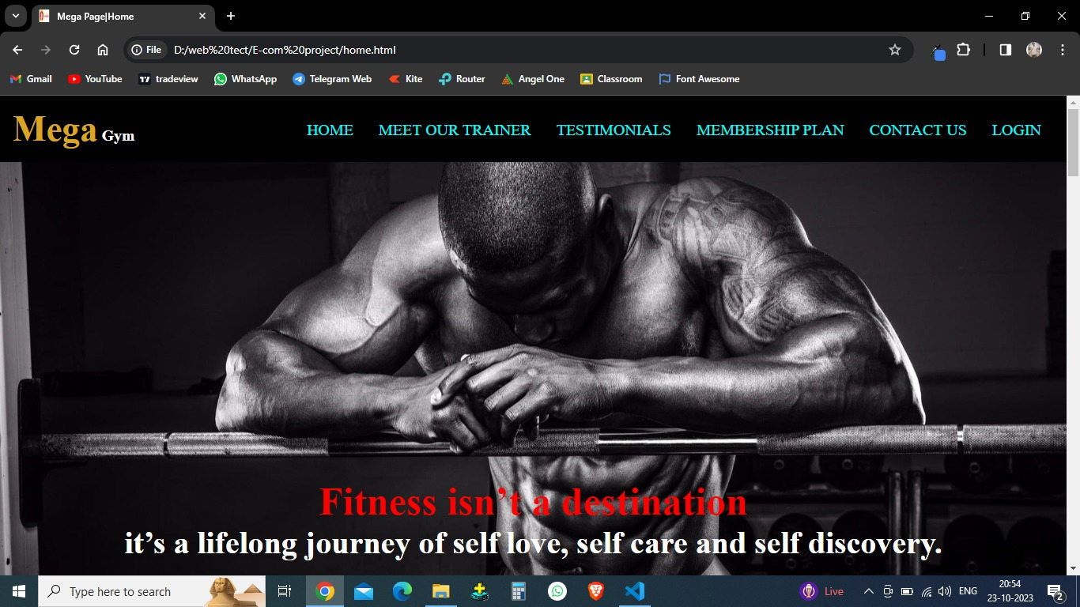
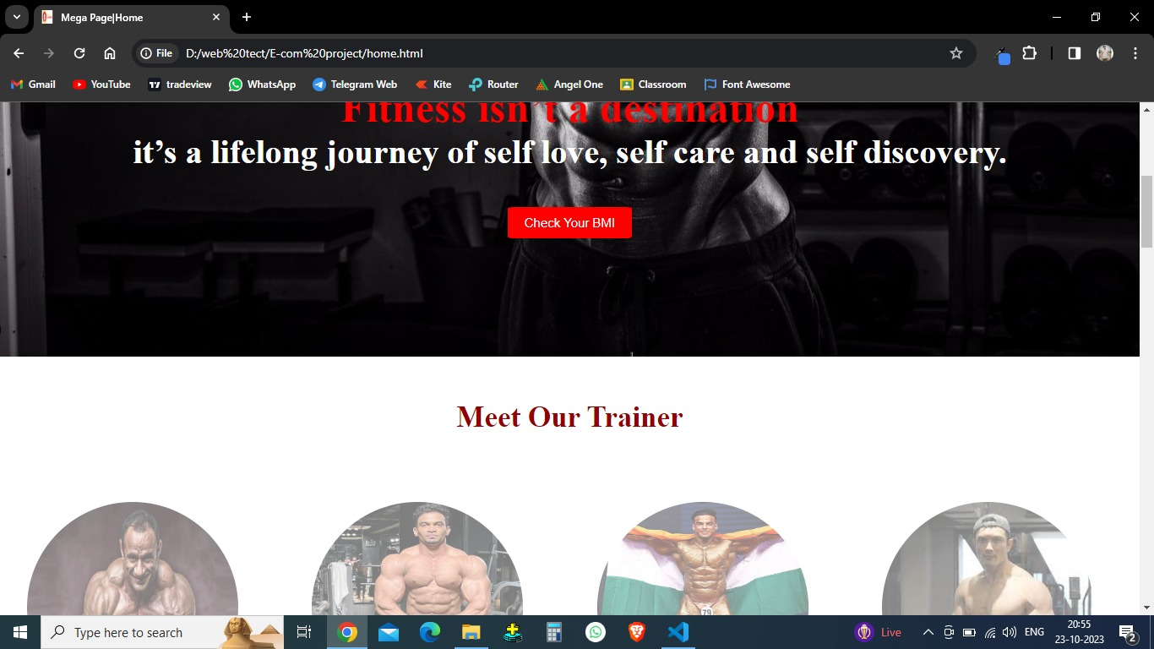
HOME PAGE
This is home page and main page this include header & main section of page.

Slide 7
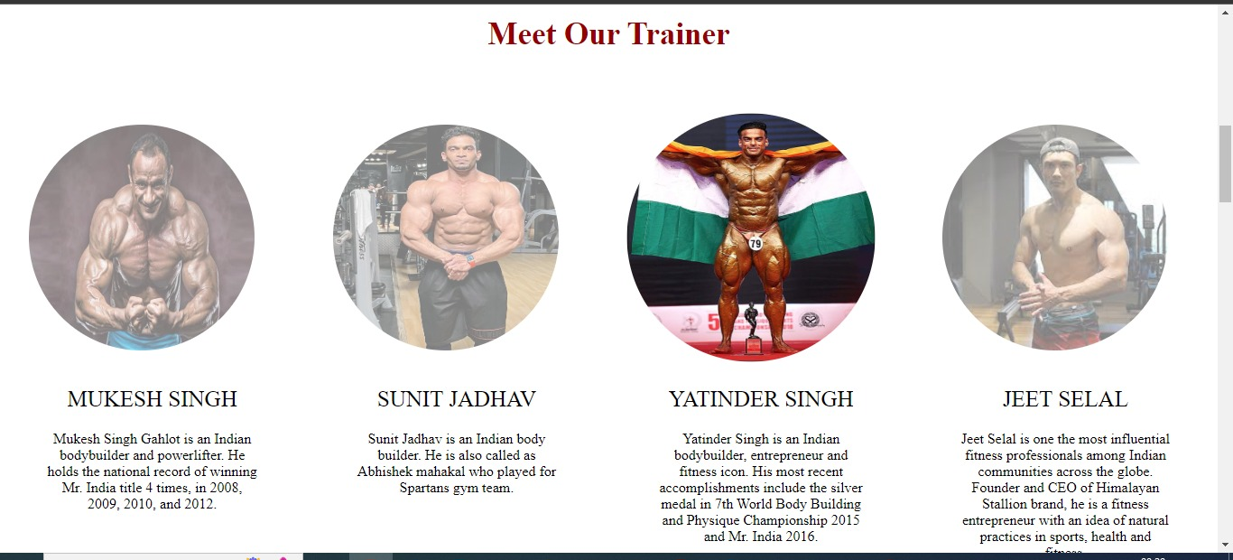
Trainer Section of Home Page
This is second section of home page of trainer in which trainer photo and describes is add and hover effect is added in image which will make photo more clear and bold.

Slide 8
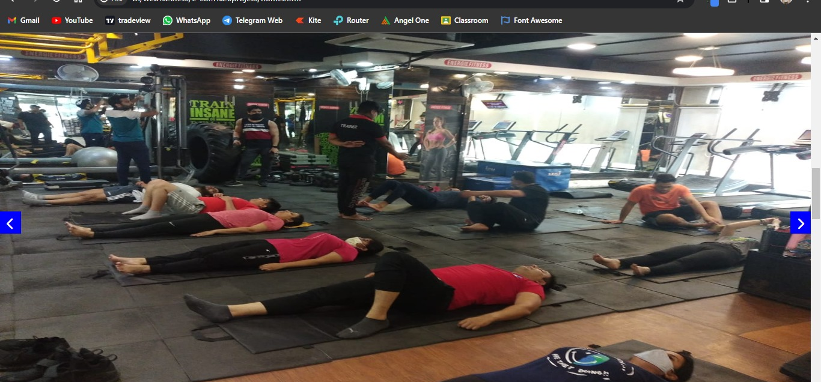
Gallery Section of Home Page
This is third section of home page of gallery in which gym and gym activity photo and this is carousel with the help of javascript.

Slide 9
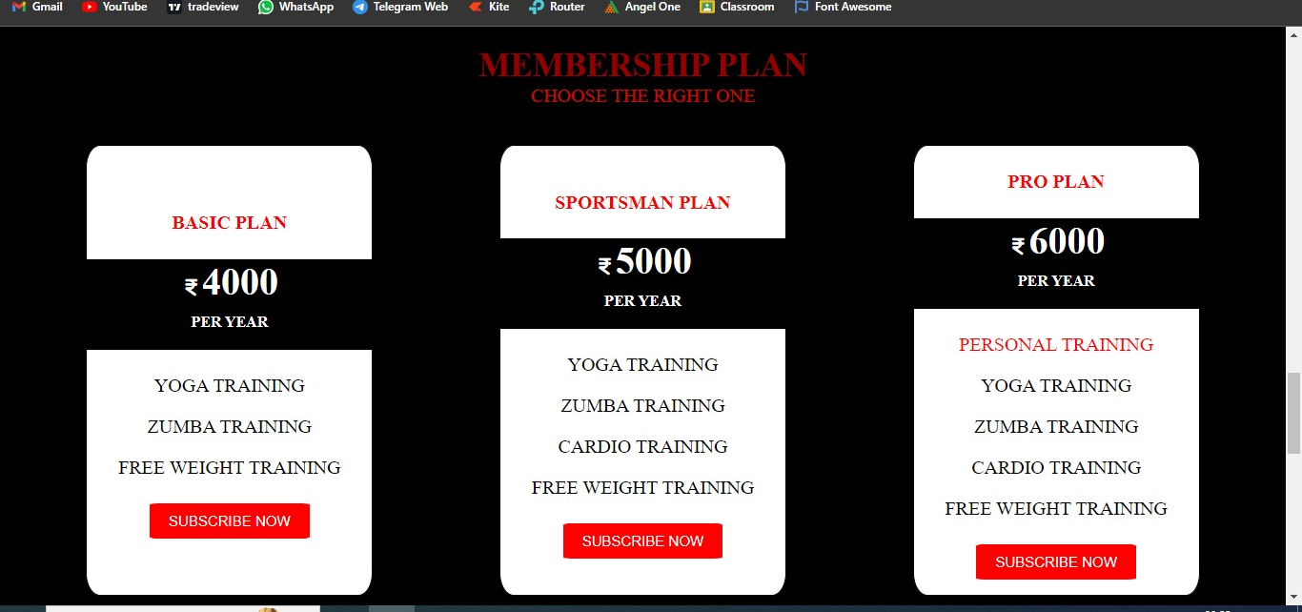
Subscribe or Plan Section of Home Page
This is forth section of home page of gym membership plans with there attribute and charges you can gets direct membership by click on subscribe now and it will redirect to payments page.

Slide 10
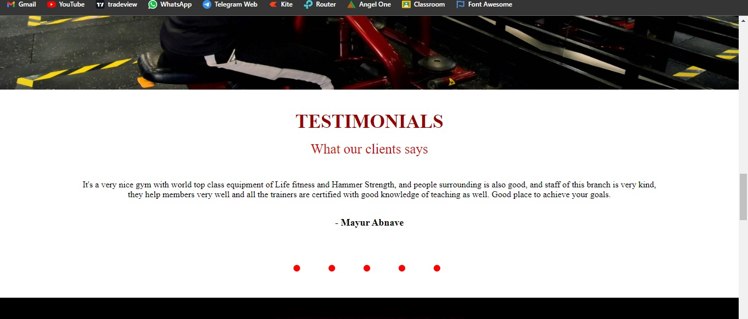
Testimonial Section of Home Page
This is fifth section of home page which consist of review of multiple gym members this is done by onclick event on down side dots by javascript.

Slide 11
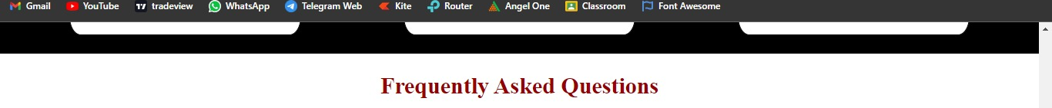
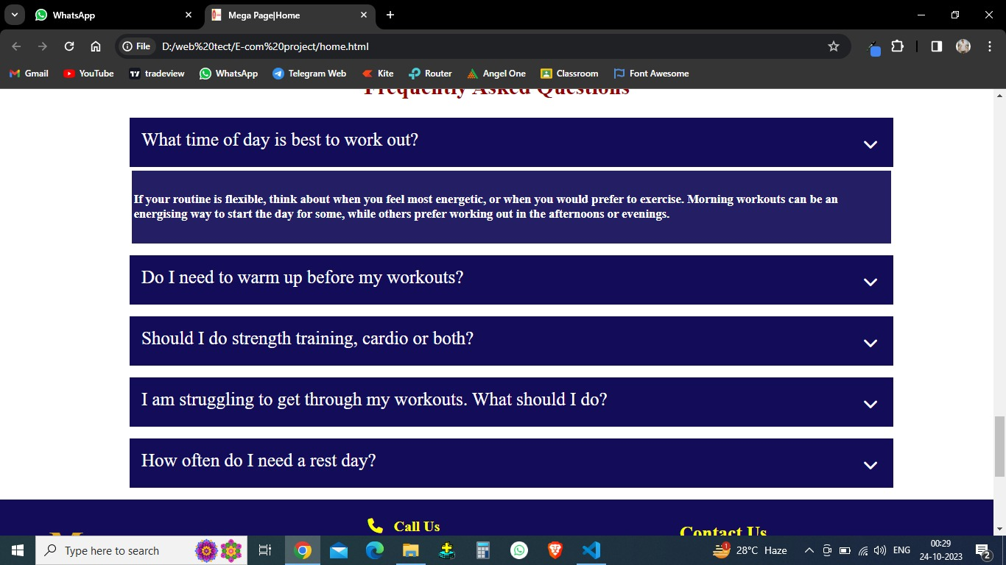
FAQ Section of Home Page
This is sixth section of home page which consist of most ask question with there answer by click on question this is done by java script.

Slide 12
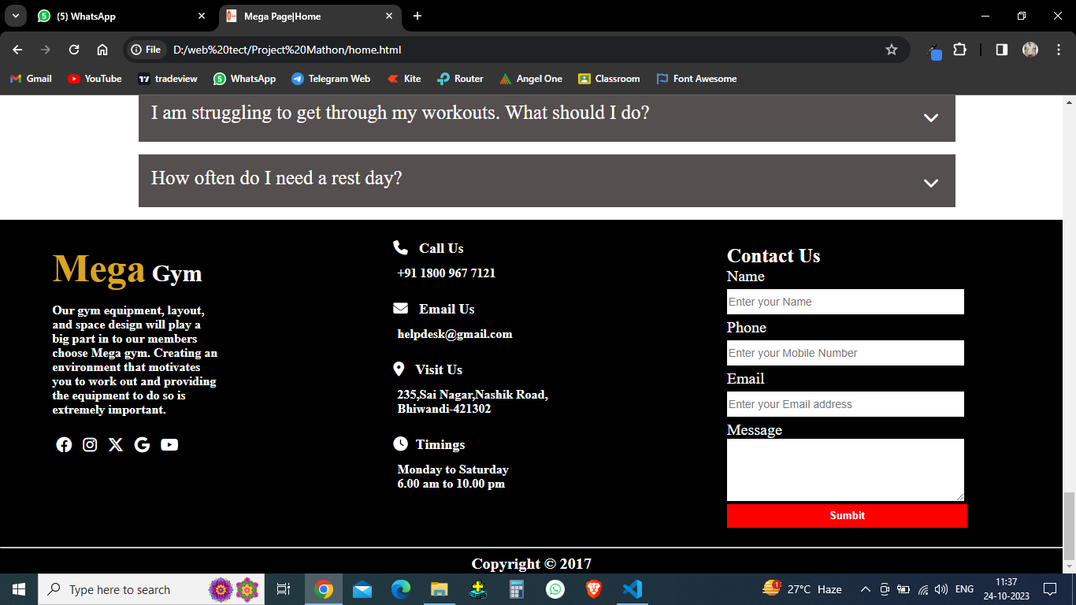
Footer Section of Home Page
This is last section of home page which consist contact details and user can directly contact us by putting message.

Slide 13
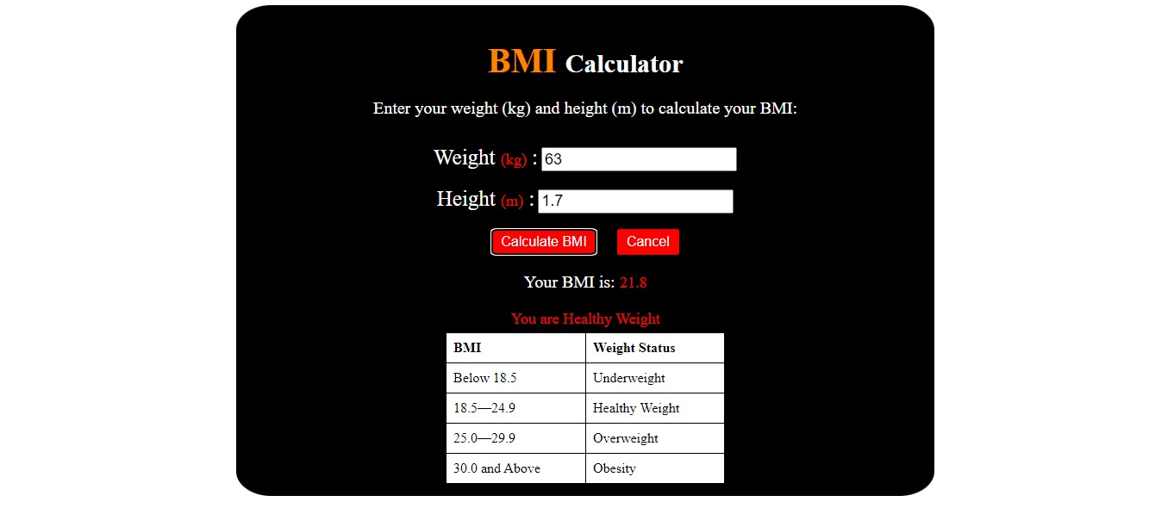
BMI CALCULATOR PAGE
This is BMI calculation page if customer is click in check BMI button of home page or member page to check his his/here BMI then his page will help him and give output with his weight status his is achieve by help of javascript.

Slide 14
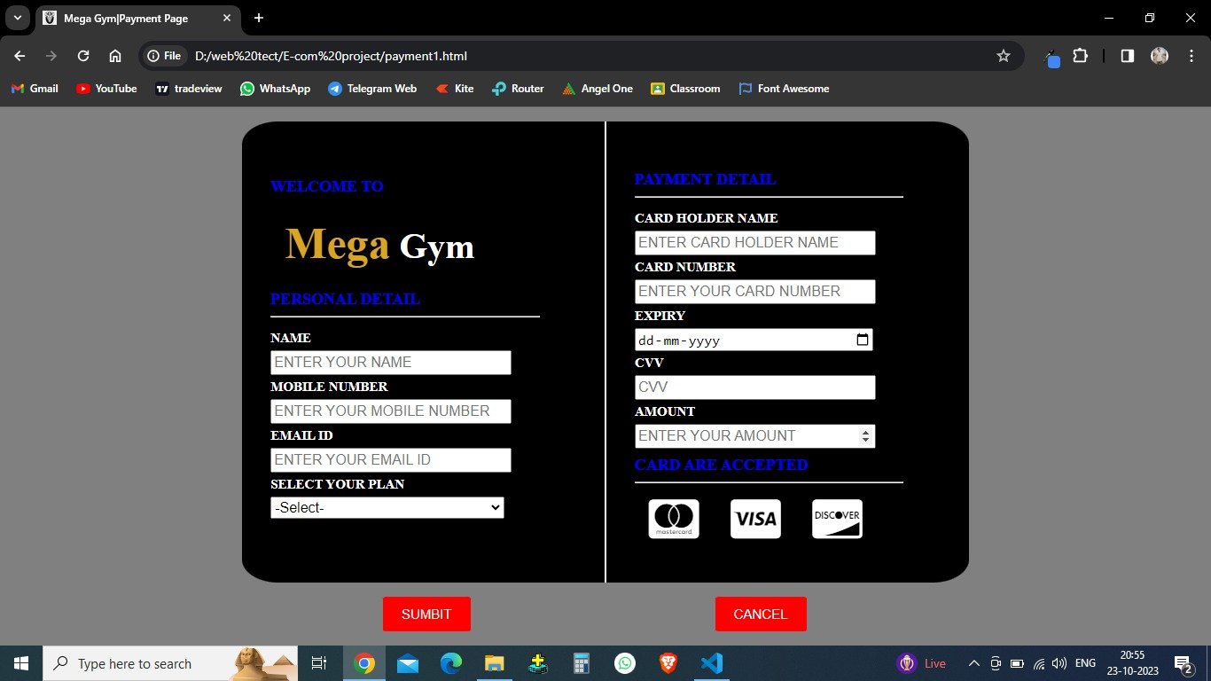
PAYMENT PAGE
This is payment page if customer is click in subscribe button of home page or member page to enroll himself then this page will appear and payment will done here by validation of each input once payment is then one notification is come has successfully payment has done and data will store in local storage.

Slide 15
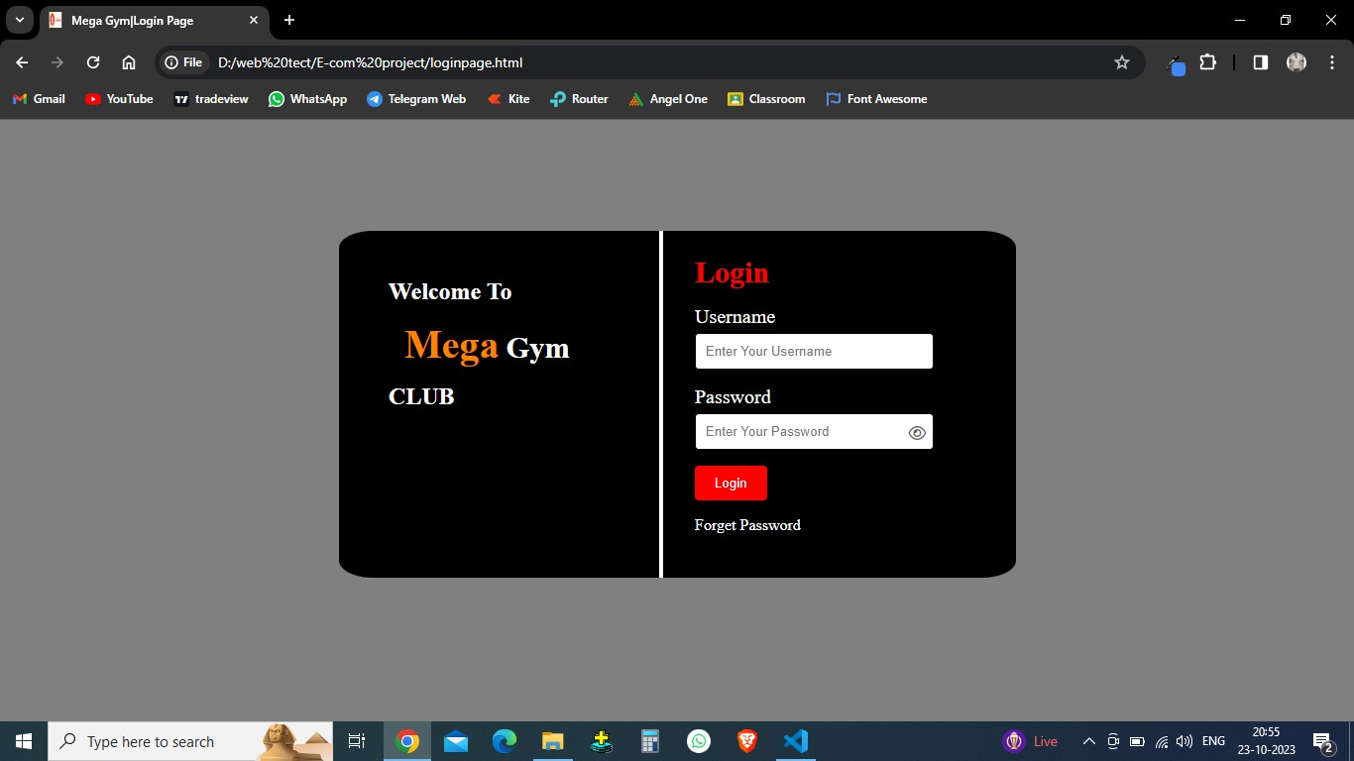
LOGIN PAGE
This is login page if customer is click on login in home page then this will appear and if username and password is correct then it will redirect to member page and if incorrect then it will give notification by page ,his is achieve by help of java script.

Slide 16
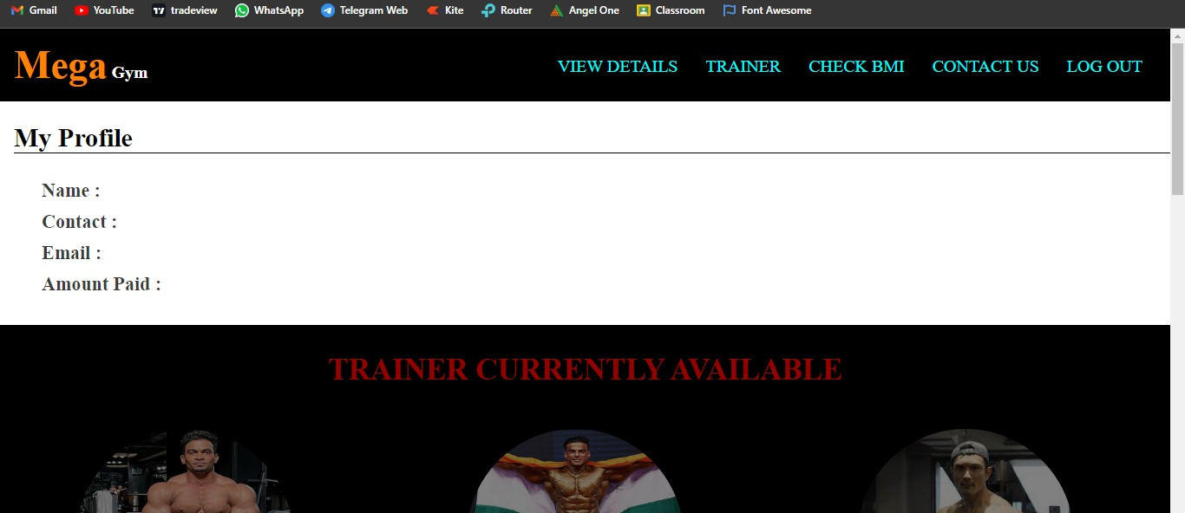
MEMBER PAGE
This is member page there member can view his details which he save at the time of payment by simply click on view details on header section and also check current available trainer and BMI.

Slide 17
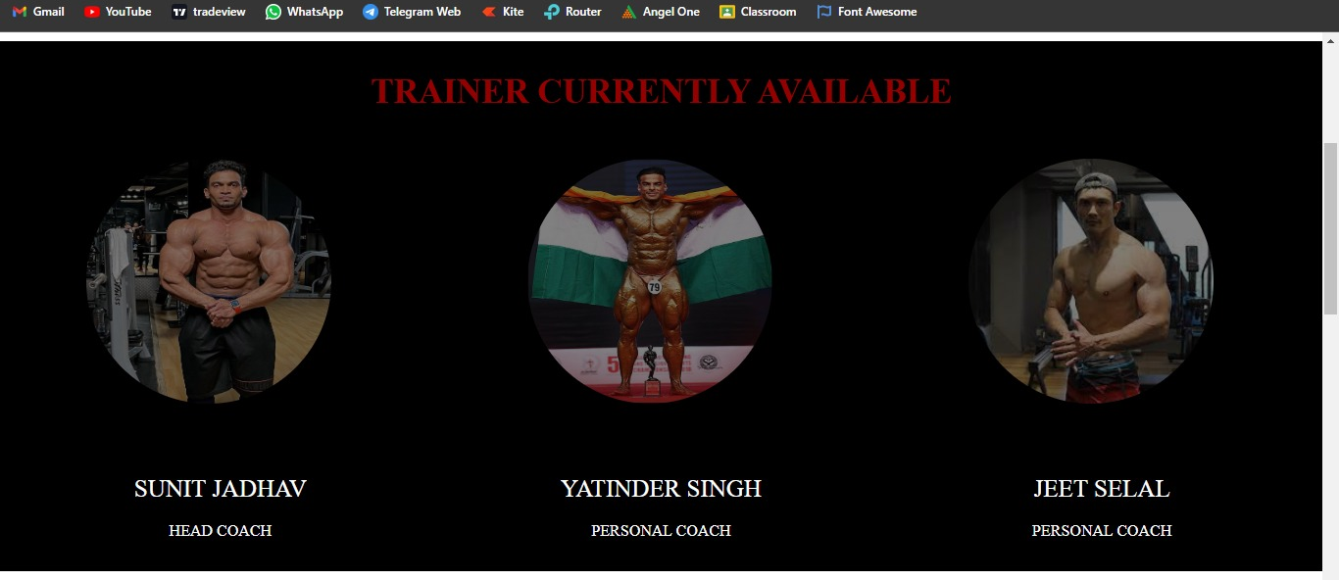
Trainer Section of Member page
This is second section member page which show the current available trainer in gym.

Slide 18
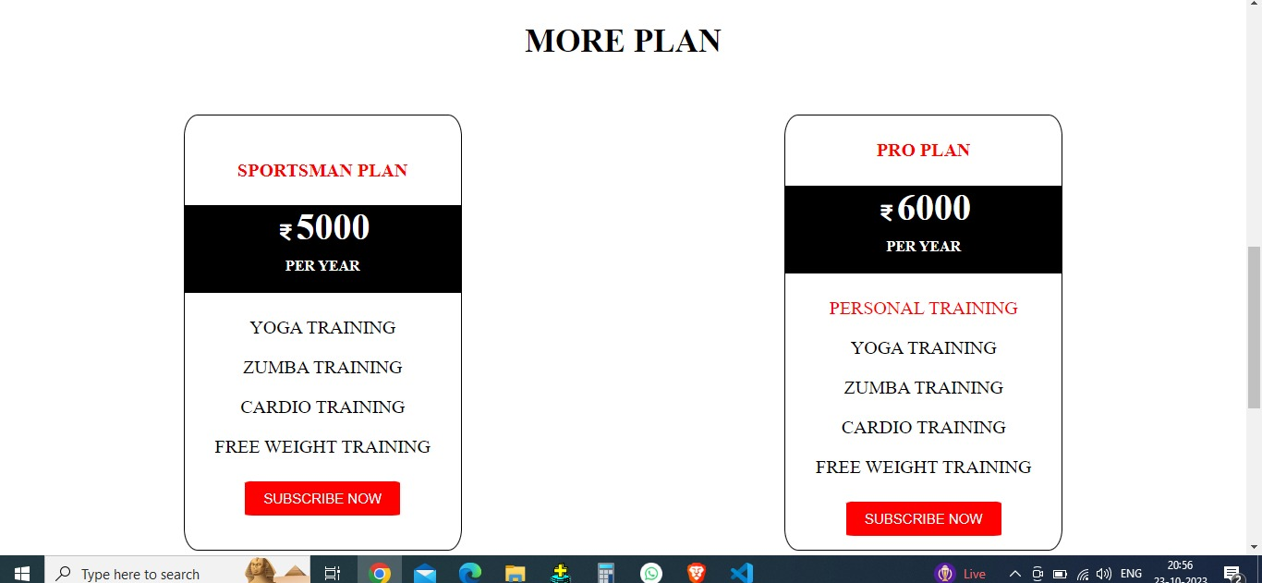
More Plan Section of Member page
This is third section member page which show the more plan option to member to upgrade his membership.

Slide 19
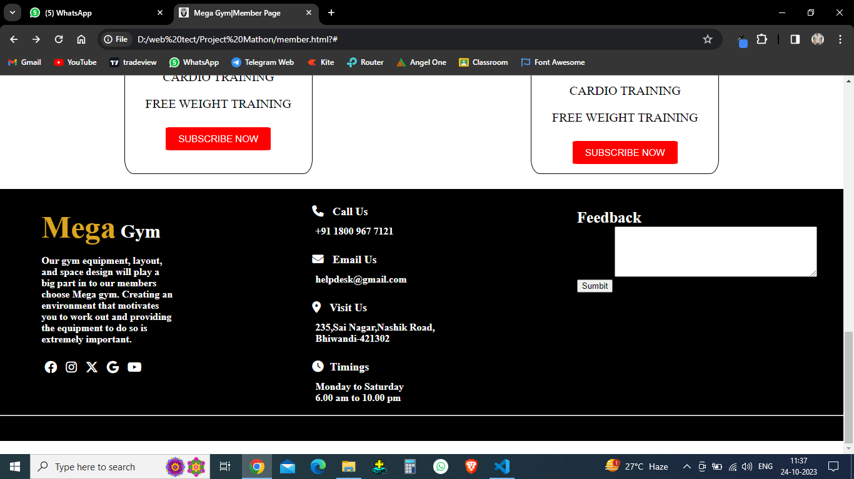
Footer Section of Member page
This is final and last section of member page where he can sent feedback to gym.

Slide 20
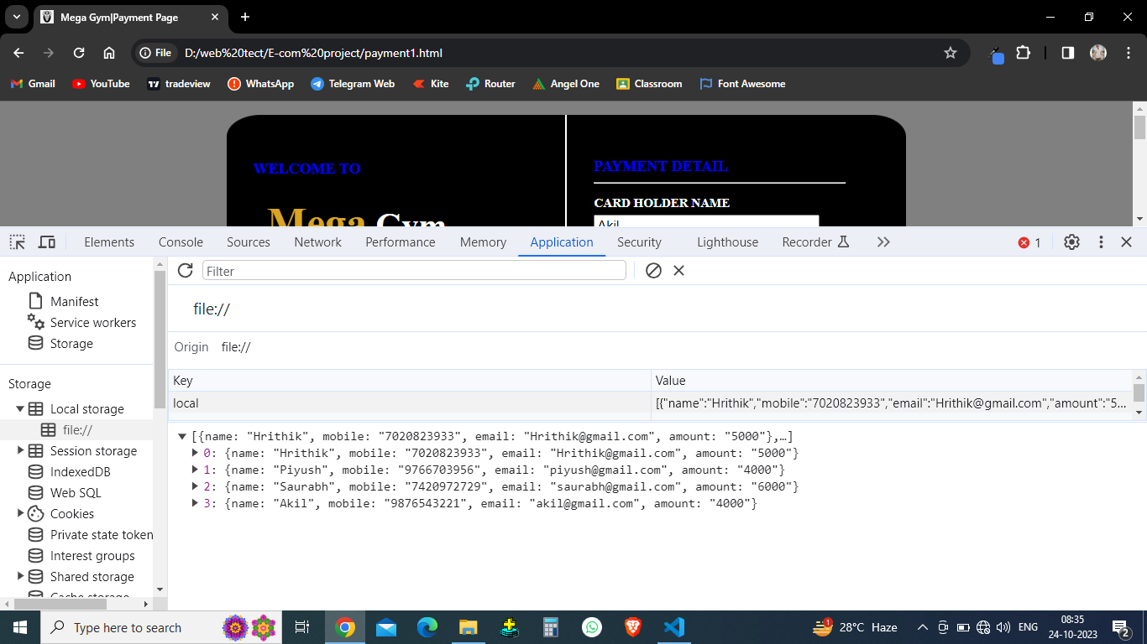
LOCAL STORAGE as Database
This is local storage which use to store the data

Slide 21
CONCLUSION
The implementation of a digital membership system and reduced administrative workload and minimized errors related to membership data.
The project has also improved financial management through online payment processing this improved overall financial transparency.
The project has established a feedback mechanism where member can provide their suggestion and concerns, which is invaluable for continuous improvement and maintaining member satisfaction.

Slide 22
FUTURE ENHANCEMENT
We can add attendance process for members.
We can create one and one chat for trainer and member to ask better suggestion for diet or workout.

Slide 23
REFERENCES
https://www.bodyzonegym.in
https://goldsgym.in/
Some of the concept of this website and other are by own.

Slide 24
THANK YOU

